Slide 1
Inkwell 2.0 Launch
Product review · November 2026
Notes:
Welcome everyone and introduce the team.

Slide 2
Agenda
• What we shipped
• Customer results
• Launch timeline
• Questions

Slide 3
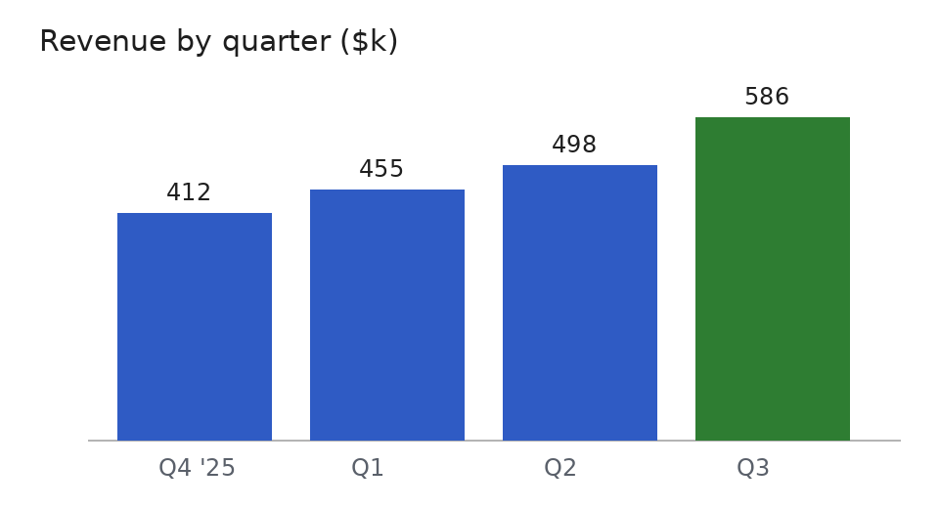
Results
Revenue +18% on Q2
42 new customers
Rating 4.7 / 5

